Slide 1
College Automation System
Student Billing
Arpan Kar
Friday, 16 October 2015

Slide 2
Key Features
Multiple Document Interface (MDI) environment
Minimal daily job
Exhaustive reports
Configurable environment
Single click new year update
Easily attachable with other College Automation System plug-ins

Slide 3
What do you do everyday?
Generate and Print Bills:
Admission for new student
Admission for old student
Examination
Tuition
Generate Reports

Slide 4
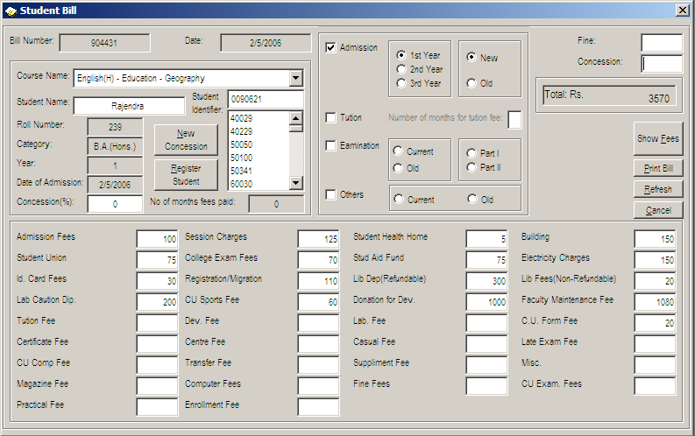
How the bill looks like?

Slide 5
Steps for New Admission
Select Billing type and year
Select course
Enter student name
Register
See total billing amount (Optional)
Print bill

Slide 6
Steps for Admission of existing student
Select Billing type and year
Select student
See total billing amount (Optional)
Print bill

Slide 7
Steps for tuition fees of existing student
Select Billing type and year
Specify number of months (Alert for due)
Select student
See total billing amount (Optional)
Print bill

Slide 8
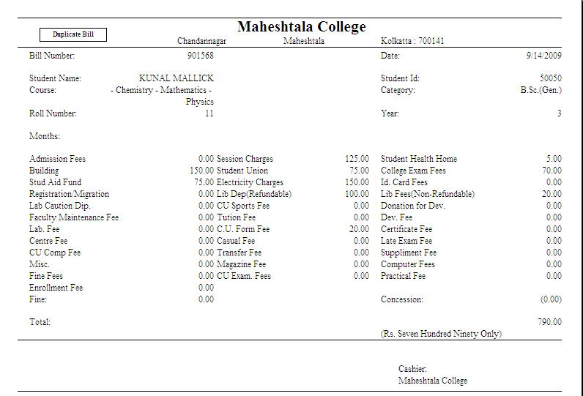
Printed Bill

Slide 9
Special ability in billing
Can define general concession
Can offer individual concession
Can charge individual fine
Can generate old tuition bill for passed out student

Slide 10
Student Information
Manage student information related to bill
Print duplicate bill
Check student wise bill payment history
History of past students

Slide 11
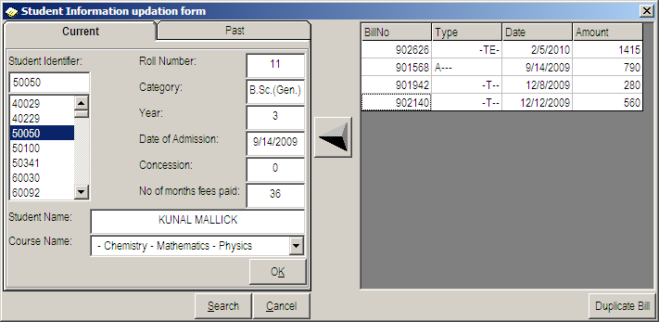
Student Information

Slide 12
Customize environment
Manage category (B.Sc. (H), B.A., etc.)
Manage subject
Manage course
Manage fees

Slide 13
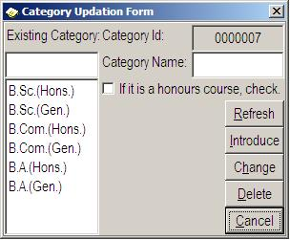
Category

Slide 14
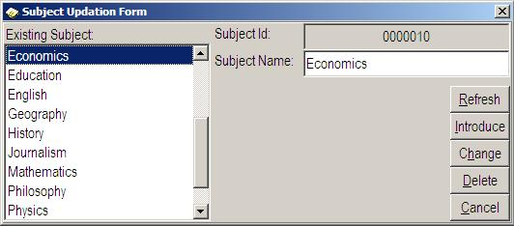
Subject

Slide 15
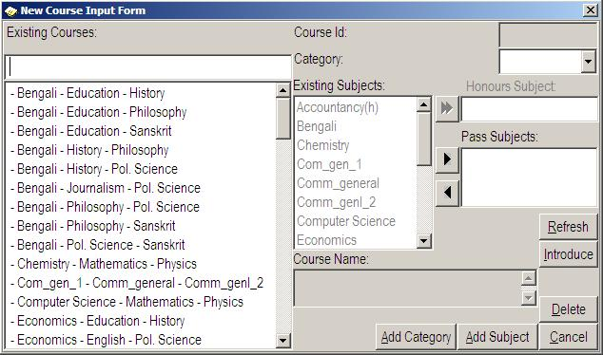
Course

Slide 16
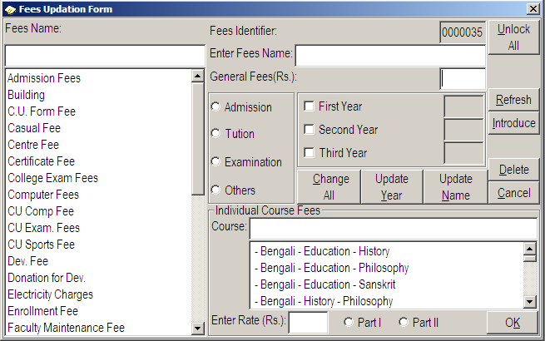
Fees

Slide 17
Report
Student List
Fees chart
Due list

Slide 18
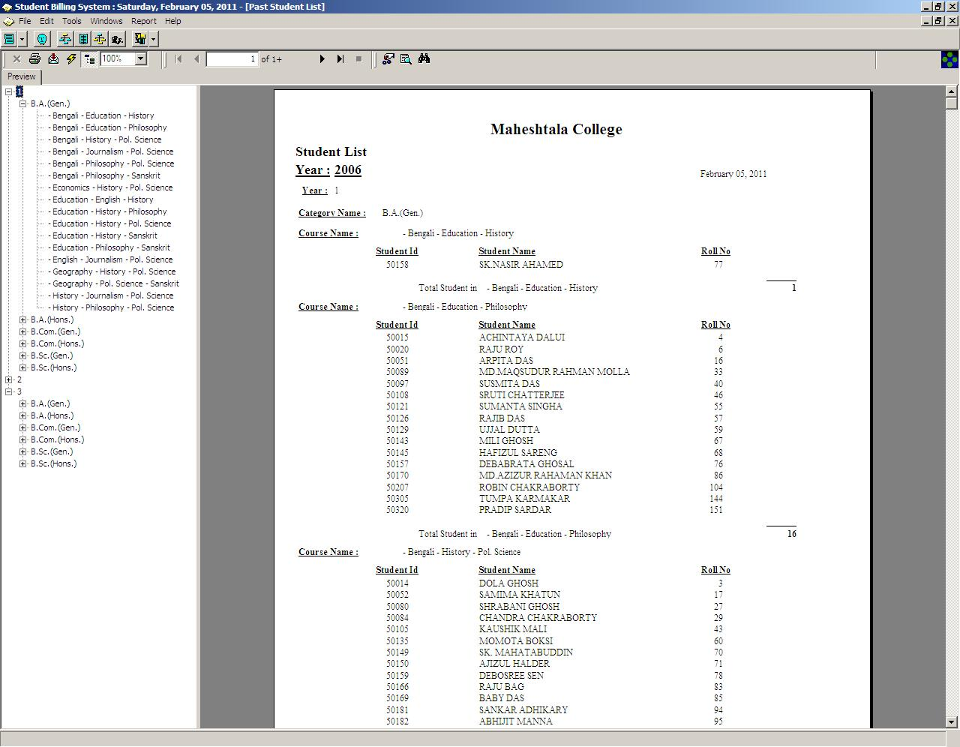
Student list
Report to view all students with user friendly tree view
Ability to view past student list

Slide 19
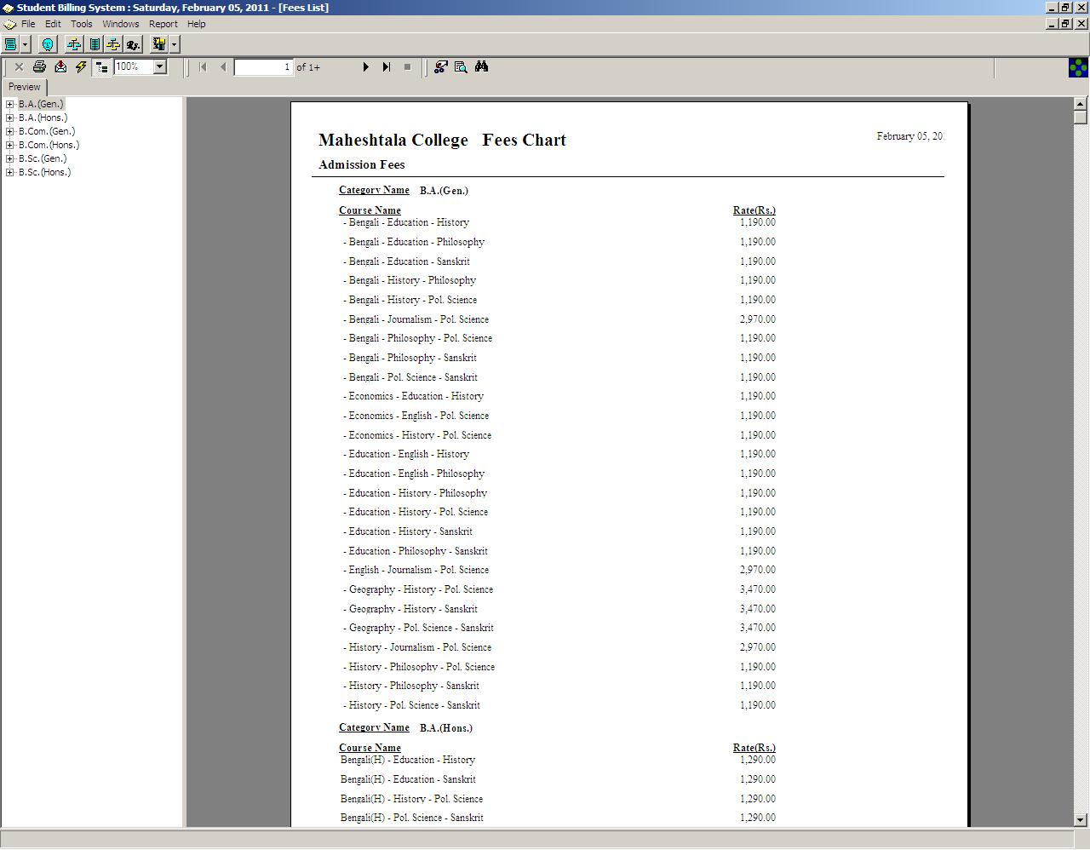
Fees chart
Report to view all fees with user friendly tree view

Slide 20
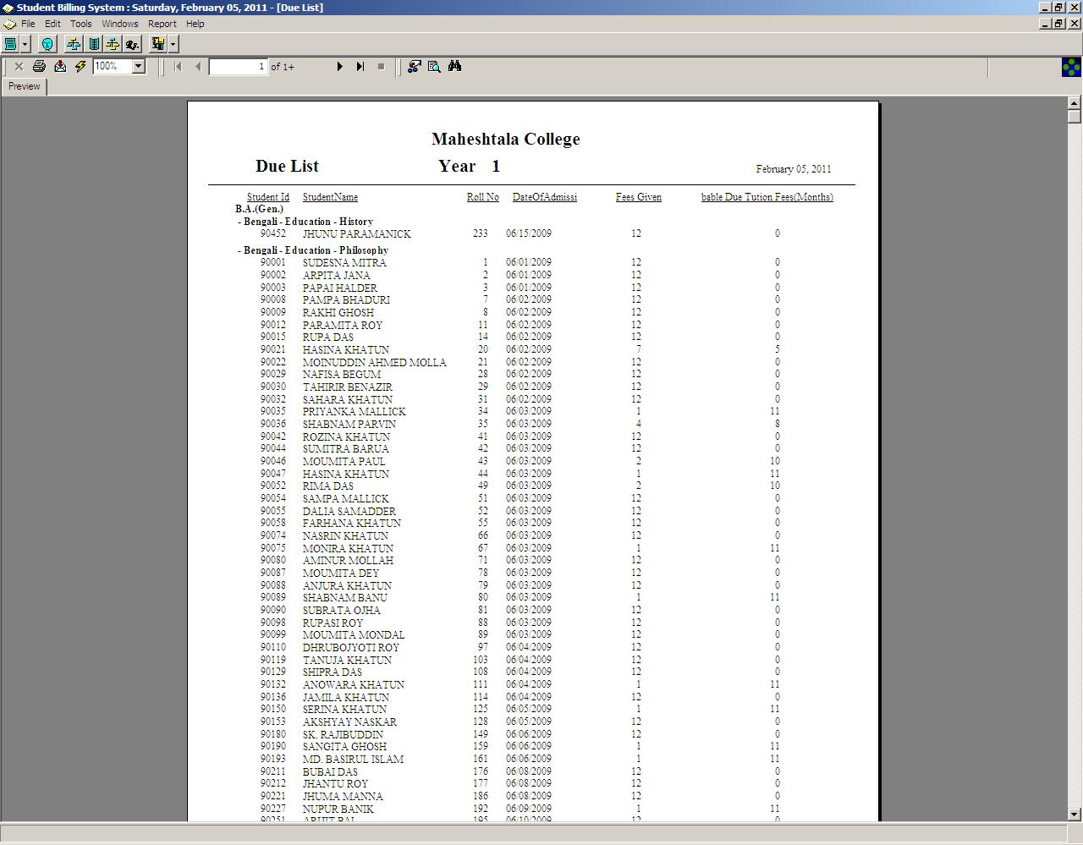
Due List
Report to check all due payment of the students

Slide 21
New Year Update
Simple three clicks
1st click for Year 1
2nd click for Year 2
3rd click for Year 3
Verify old payment due list

Slide 22
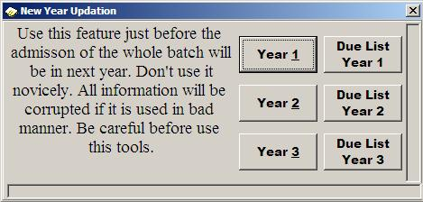
New Year Update

Slide 23
Arpan Kar
(91) 98864 08746
arpan.kar@binaryaffairs.com

